Slide 1
Domestic Violence Assessment and Intervention for Clergy
Kimberly Lenggiere, LMFT, LAC
Juvenile SOMB Provider
Animal Assisted Therapist
AAMFT Approved Clinical Supervisor Candidate

Slide 2
Susan Powell

Slide 3
WHAT IS DOMESTIC VIOLENCE?
Also known as intimate partner violence
A pattern of behaviors used by one partner to maintain power and control over another partner in an intimate relationship.

Slide 4
MYTHS
If the abuse was that bad, victims would leave.
Victims are often to blame because they provoke their partner’s violence.
Domestic violence is an impulse control or anger management issue
Domestic violence is bad, but it doesn’t happen in my community/culture/faith/etc.
It is easy for victims to leave domestic violence situations.
Abuse is only physical.
Abusers are only men.

Slide 5
FACTS
Every act of abuse must be taken seriously. Even if a victim’s life does not seem to be in danger, abuse of any kind has long lasting negative effects.
Whatever problems exist in relationship dynamics, violence and abuse are never okay –there is no excuse for domestic violence.
Abusers act deliberately and choose who to abuse.
Domestic violence happens in every community to people of every background.
Fear, lack of resources, and lack of safe opportunities prevent victims from leaving.
Abusers use a variety of tactics to harm their victims, including physical, emotional, verbal, spiritual, and sexual abuse.
Women can also be domestic violence perpetrators.

Slide 6
Abuse is abuse
In the world of offender treatment, each kind of abuse is acknowledged for what it is. All kinds of abuse are abuse, are must be recognized and corrected.

Slide 7
RELATIONSHIP HEALTH IS A SPECTRUM
In healthy relationships partners
Communicate openly
Respect each other
Trust each other
Are honest
Are equal
Enjoy personal time
Make mutual sexual choices
Are financial partners
Engage in supportive parenting
In unhealthy relationships partners
Don’t communicate
Are disrespectful to each other
Are dishonest
Try to take control
Only spend time with their partner
Pressure each other into sexual activity
Ignore each other’s boundaries
Are unequal economically
In abusive relationships partners
Communicate in harmful ways
Mistreat each other
Accuse their partners of cheating when it’s not true
Deny their actions are abusive
Control their partner
Isolate their partner
Force sex or pregnancy
Exert economic control
Engage in manipulative parenting

Slide 8
WHY VICTIMS DON’T LEAVE

Slide 9
WHY VICTIMS DON’T LEAVE
Trauma
Fear
Believing abuse is normal
Fear of being outed
Embarrassment or shame
Low self esteem
Love
Cultural/religious reasons
Language barriers and immigration status
Lack of money or resources
Disability

Slide 10
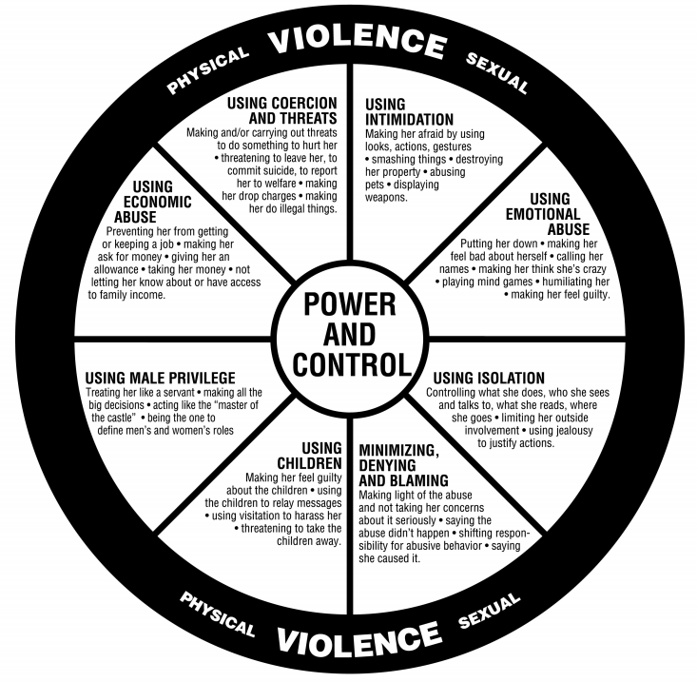
POWER AND CONTROL WHEEL
This wheel is a diagram of tactics abusers use to keep their partners in the relationship.

Slide 11
POWER AND CONTROL WHEEL
USING COERCION AND THREATS
USING INTIMIDATION
USING EMOTIONAL ABUSE
USING ISOLATION
MINIMIZING, DENYING, BLAMING
USING CHILDREN
USING MALE PRIVILEGE
USING ECONOMIC ABUSE

Slide 12
SIGNS OF AN ABUSIVE PARTNER
Belittles their partner with shame, insults, and put downs.
Shows extreme jealousy when their partner spends time with friends, community, or family.
Discourages their partner from seeing their support system.
Says things to their partner like, “You can’t do anything right.”
Controls every penny the household spends.
Makes all decisions for their partner.
Their partner expresses fear about the person.
Controls what their partner is allowed to do, who they can see, and where they can go.
Threatens to take away they kids or tells their partner, “You’re a bad parent.”
Prevents their partner from working or attending school.
Destroys property or hurts/kills pets.
Intimidates their partner with guns, knives, or other weapons.
Pressures their partner into sex, alcohol consumption, or drug use.

Slide 13
CONSENT
Consent is a mutual agreement between partners about what they want to experience.
Consent needs to happen every time a couple engaged in a physical act.
Relationship status does not make consent automatic.
There is no such thing as ‘implied consent.’
Consent is not a free pass.
It is NOT consent if, for any reason, a partner is afraid or unable to say no.
No means no, and stop means stop.

Slide 14
SPIRITUAL AND RELIGIOUS ABUSE
Using faith, cultural norms, scripture, and traditions to assert power and control.
Prolonging abusive relationships
Isolation
Using community coercion
Blaming the victim
Restricting access to or use of health care
Using children
Controlling sexuality or reproduction
Asserting authority

Slide 15
CATHOLIC CONSIDERATIONS
Prevalence of home schooling
Natural family planning and the potential for using pregnancy to control or abuse
Issues related to male authority
Using scripture to manipulate
Using Church teachings regarding divorce to control or manipulate
Using sin or shame as a way of manipulating
The position of men in leadership

Slide 16
SCREENING –GUIDING PRINCIPLES
Treat each potential victim with dignity, respect, compassion, and openness to their story no matter what their reputation or your connection to their family.
Recognize that the process of leaving an abusive relationship is long and gradual –on average it takes 7 attempts to leave a domestic violence situation.
Always have resources readily available to help engage survivors in continued care and support throughout the process of attaining greater safety and control in their lives.
The safety of victims and children is the top priority.

Slide 17
SCREENING
Parishioners who come to you for counsel and exhibit some of these issues are worth screening:
Alcohol and drug abuse
Prior trauma history
Seem accident pro
ne
Eating disorders
Injury during pregnancy
Never alone, or partner never lets them speak to you privately
Psychological distress such as depression, suicidal ideation, anxiety
Scrupulosity

Slide 18
SCREENING
Screen in a safe environment. Never ask in front of a partner.
Use your own words in a non-threatening way. “Domestic violence is a common issue so I ask all of my parishioners when I meet with them.”
Use specific, direct questions:
Do you feel safe in your relationship?
Have you or your children been threatened or abused in any way by your partner?
Is there a partner from a previous relationship who is making you feel unsafe?
Be honest about any mandating reporting in regards to any disclosures about children.

Slide 19
SCREENING
If domestic violence is disclosed:
Be supportive with statements such as
“No one deserves to be abused.”
“There is no excuse for domestic violence.”
“This is not your fault.”
“You are not alone, there are people who can help you.”
“It must be very difficult to leave, or know what to do. We are here to help when you’re ready.”
Victims may not realize they are experiencing domestic violence, and may need some education about what abuse looks like.

Slide 20
INDICATORS OF LETHALITY
Abuse beginning when a victim is pregnant.
Use of substances.
Strangulation.
The victim’s concern for safety

Slide 21
LETHALITY ASSESSMENT
Before the victim leaves, assess any immediate danger such as:
Increase in frequency or severity of assault
Increase of new threats of homicide or suicide
Threats to children
A firearm or deadly weapon in the home
Ask the question, “will you be safe to return home?”
If the victim does not feel safe to go home, ask if there is a safe place for them to go to. Have emergency resources available.
If the victim does feel safe to go home, ask what kind of assistance they would like, or what actions they are ready to take.
Check in about thoughts of suicide.

Slide 22
SAFETY PLANNING
Anyone can help a victim of domestic violence write up a simple safety plan for home and the work place.
These plans contain simple but critical steps you can take to increase safety while living in a domestic violence situation.

Slide 23
PERSONAL SAFETY PLANS
Have the following available in case you need to flee:
Important documents such as birth certificates, social security cards, insurance info, school and health records, welfare and immigration documents, and divorce or other court documents.
Credit cards, bank account numbers, ATM cards.
Cash.
An extra set of keys.
Medications and prescriptions.
Phone numbers and addresses for family, friends, doctors, lawyers, and community agencies.
Clothing and comfort items for you and any children.

Slide 24
PERSONAL SAFETY PLANS
If you are living alone, you may want to:
Change locks on doors and windows.
Install a security system or improve the current one –add bars to windows, locks, better lighting, smoke detectors and fire extinguishers.
Teach your children to call the police or family and friends if they are snatched.
Talk to schools, neighbors, and childcare providers about who has permission to pick up the children.
find a lawyer that is knowledgeable about family violence to explore custody, visitation, and divorce provisions that protect victims and children.
Obtain a restraining order.

Slide 25
PERSONAL SAFETY PLANS
If you are leaving an abuser, know the answers to these questions:
How and when can you most safely leave? Where will you go?
Are you comfortable with calling the police if you need them?
Who can you trust to tell if you’re leaving?
How will you travel safely to and from work or school to pick up children?
What community and legal resources will help you feel safer?
Do you know the number of the local shelter?
What custody and visitation provisions will keep you and your children safe?
Is a restraining order a viable option?

Slide 26
PERSONAL SAFETY PLANS
If you are staying with your abuser, think about:
What works best to keep you safe in an emergency?
Who can you call in a crisis?
If you would call the police if any violence occurs/starts again. Can you work out a signal with the children or neighbors to call the police when you need help?
If you need to flee temporarily, where would you go? Think through several options where you could go in a crisis. Write down the names and addresses and keep them with you.
If you need to flee your home, know the escape route in advance.

Slide 27
WORK PLACE SAFETY PLAN
Save any threatening emails or voicemail messages in case they are needed for future legal action, or as evidence that a restraining order was violated.
Park close to the entrance of the building, and talk to security, your managers, and the police if you fear an assault at work.
If possible, have your calls screened and transfer harassing calls to security, or remove your name and number from automated directories.
Relocate your workspace to the most secure area of the office/building.
Obtain a restraining order and keep it current and on hand –include your workplace in the order. Provide a copy to security, your supervisor, HR, and the reception area.
Ask for security to escort you to and from your car or public transportation.
Look into alternate hours and work locations if possible.
Review the safety of any childcare arrangements, and make sure they are covered in any restraining order.

Slide 28
RESOURCES
National Domestic Violence Hotline
www.thehotline.org 1-800-799-7233
National Dating Abuse Helpline
www.loveisrespect.org 1-866-331-9474
National Center on Domestic Violence, Trauma, and Mental Health
www.nationalcenterdvtraumamh.org 1-312-726-7020 ext 2011
National Sexual Assault Hotline
www.rain.org 1-800-656-4673
National Suicide Prevention Lifeline
www.suicidepreventionlifeline.org 1-800-273-8255
National Human Trafficking Resource Center/Polaris
www.polarisproject.org 1-800-373-7888

Slide 29
CONTINUED TRAINING
The Danger Assessment
www.dangerassessment.org
National Center on Domestic Violence, Trauma, and Mental Health Webinars
www.nationalcenterdvtraumamh.org/trainingta/webinars-seminars

